Slide 1





NORTH SOUTH UNIVERSITY
1ST DEMONSTRATION
Presented by
ABDULLAH AL RAIYAN - 2212712042
MD. SIFAT HAQUE ZIDAN - 2212768042
RAHIL MEHNAZ - 2121843042

Slide 2


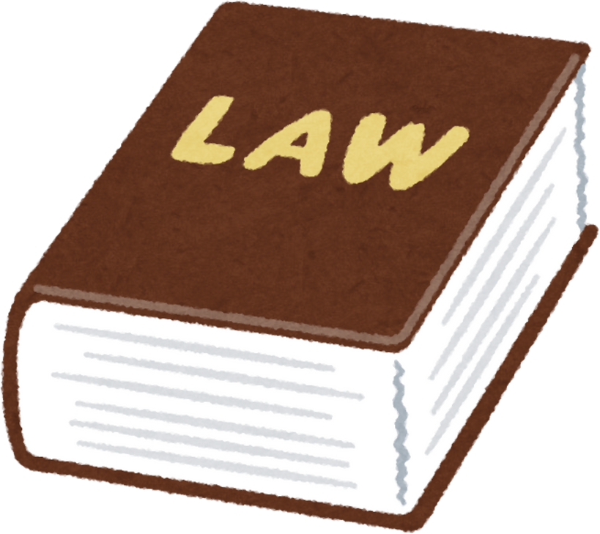
NLP-Based AI Model for Legal Assistance in Bangladesh: Enhancing Access to Law &
Citizen Rights

Slide 3
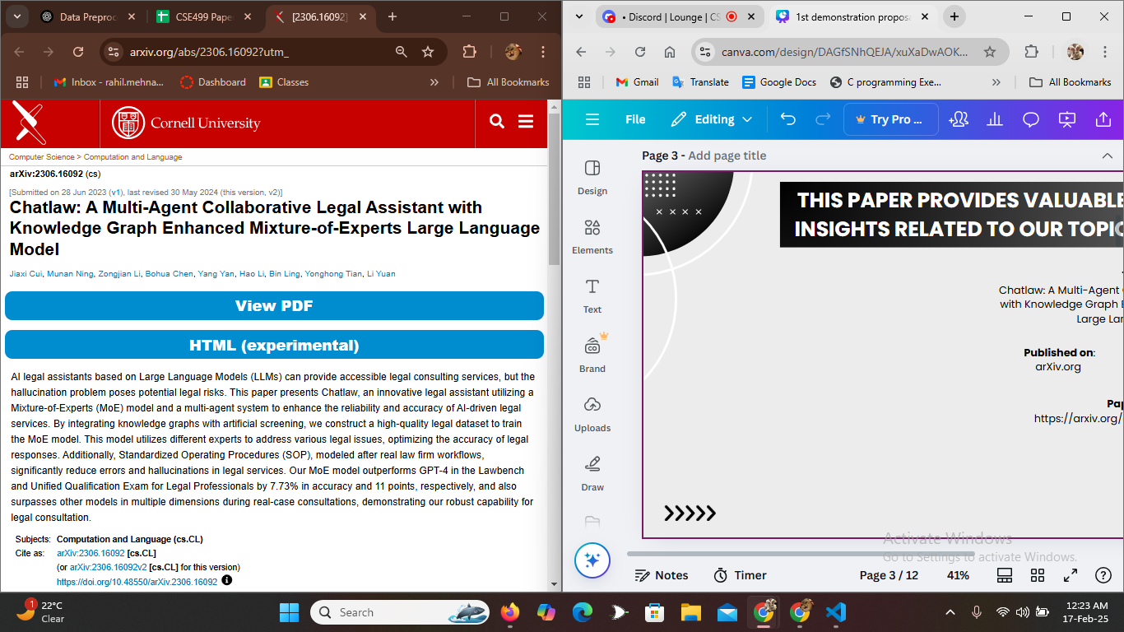
THIS PAPER PROVIDES VALUABLE INSIGHTS RELATED TO OUR TOPIC
TITLE:
Chatlaw: A Multi-Agent Collaborative Legal Assistant with Knowledge Graph Enhanced Mixture-of-Experts Large Language Model
Published on:
arXiv.org
Publication Date:
30 May 2024
Paper Link:
https://arxiv.org/abs/2306.16092?utm_

Slide 4
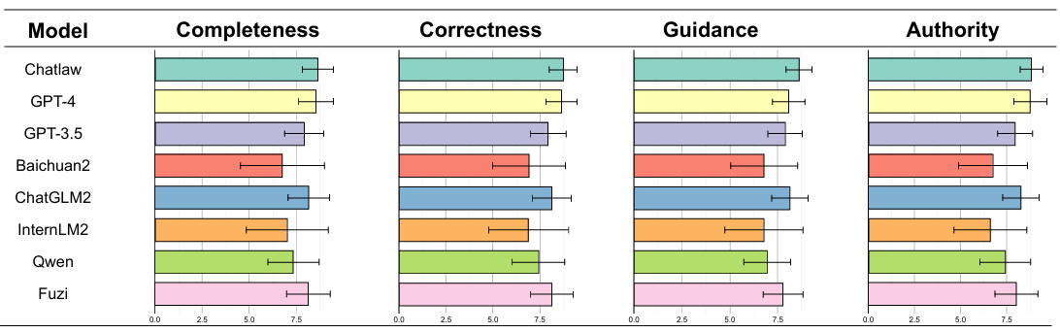
THIS PAPER PROVIDES VALUABLE INSIGHTS RELATED TO OUR TOPIC

Slide 5
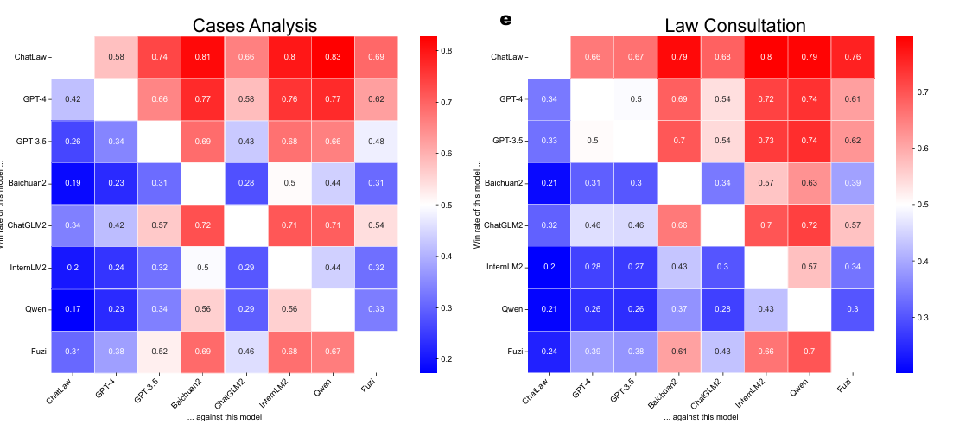
THIS PAPER PROVIDES VALUABLE INSIGHTS RELATED TO OUR TOPIC

Slide 6
LITERARY REVIEW
AI legal assistants, including LLMs like GPT-4, often suffer from hallucinations, making them unreliable for legal consultations.
  This ChatLaw mitigates the hallucinations issue by combining a multi-agent system, knowledge graphs, and an MoE model.
APPROACH

Slide 7
LITERARY REVIEW
This ChatLaw constructs a high-quality legal dataset by:
  Screening and categorizing legal cases.
  Using knowledge graphs to structure legal knowledge.
  Creating task-specific datasets for case classification, statute prediction, and legal document drafting.
  RAG for preventing hallucinations.

Slide 8
LITERARY REVIEW
ChatLaw mimics real law firm workflows using multiple AI agents:
  Legal Assistant – Gathers user queries and structures them in a knowledge graph.
  Legal Researcher – Searches the internet and databases for relevant legal statutes and precedents.
  Senior Lawyer AI – Analyzes cases and provides legal advice.
  Legal Editor – Converts advice into formal legal documents.

Slide 9
LITERARY REVIEW
Real-World Consultation Testing
  ChatLaw was tested on real legal scenarios, such as divorce cases, and provided structured legal reports.
  The AI’s legal advice included statute references, case precedents, and suggested legal actions.
  Feedback from legal experts confirmed that ChatLaw delivers more reliable and structured legal responses than GPT-4.

Slide 10
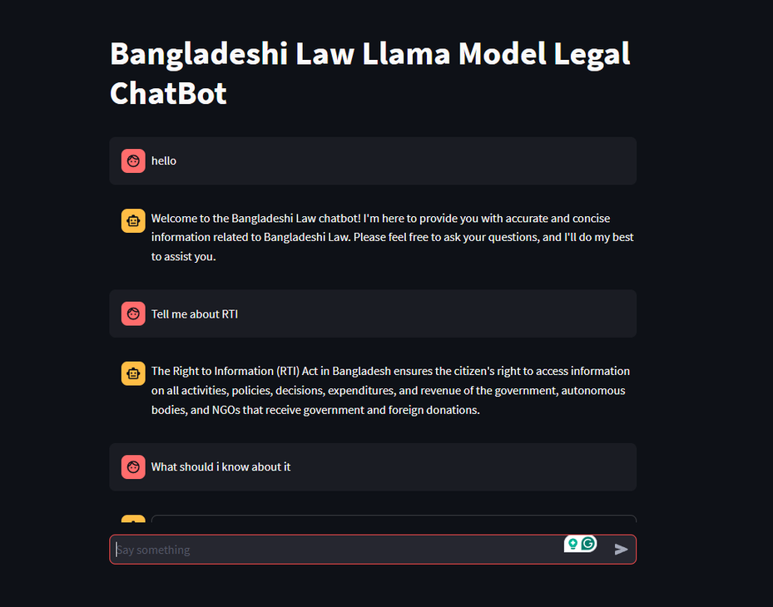
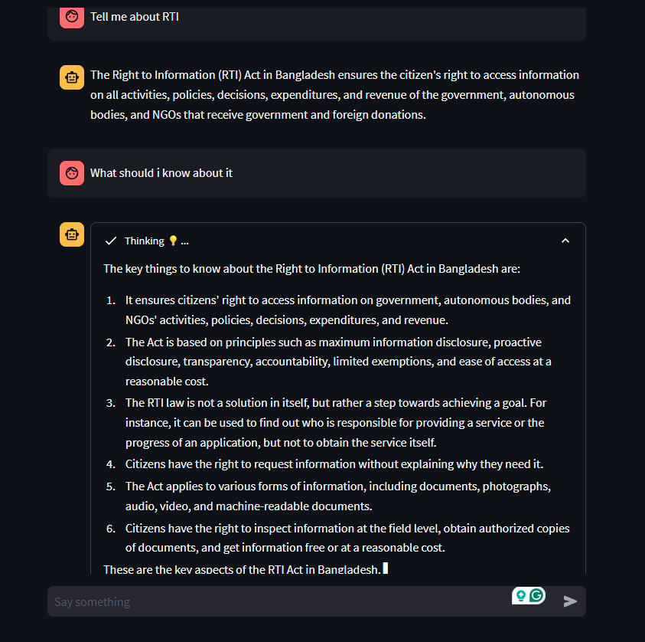
A DEMONSTARTION OF A LEGAL CHATBOT

Slide 11
A DEMONSTARTION OF A LEGAL CHATBOT CONT.
  LLM based on llama3
  runs on Google API
  responses on trained Bangladeshi data

Slide 12
THANK YOU

